Slide 1

SCIENCE_QTECH EMPLOYEE PERFORMANCE MAPPING- SQL assessment

Slide 2
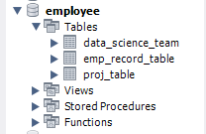

1. Create a Database named employee
Import data_science_team.csv proj_table.csv and emp_record_table.csv tables into the employee database

Slide 3
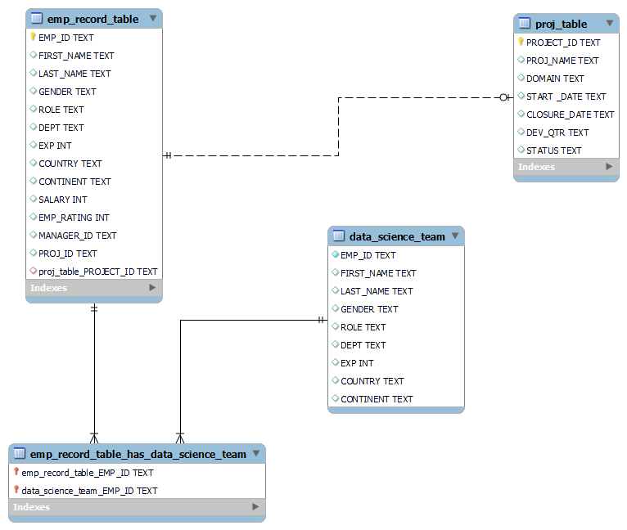
2. Create an ER diagram for the given employee database.

Slide 4
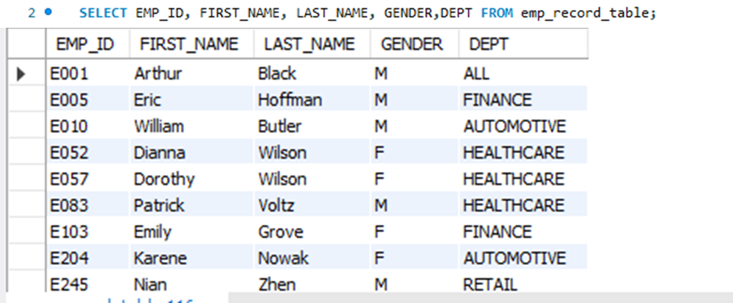
3. List of employees and details of their department

Slide 5
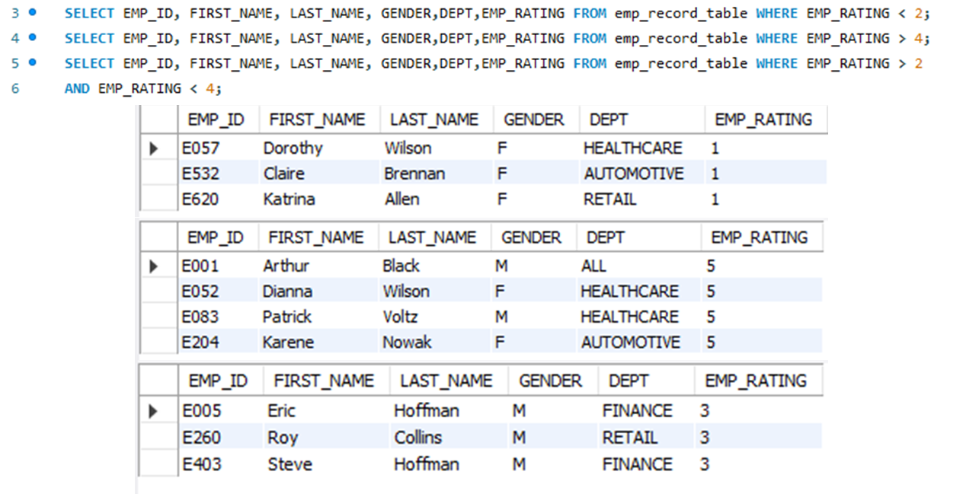
4. EMP_ID, FIRST_NAME, LAST_NAME, GENDER, DEPARTMENT, and EMP_RATING if the EMP_RATING is: i) less than two. ii) greater than four. iii) between two and four.

Slide 6
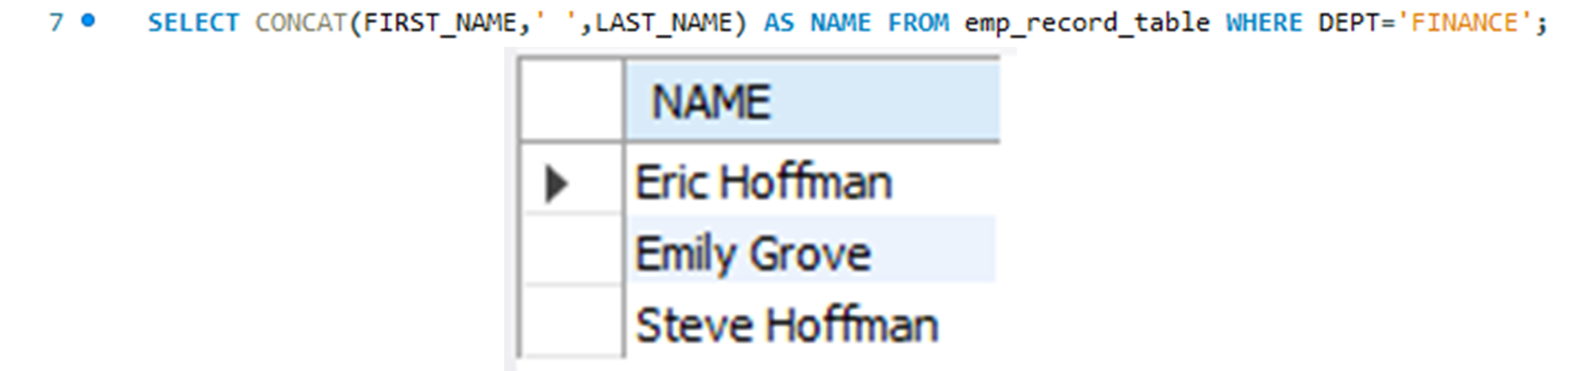
5. Query to Concatenate First Name and Last Name of Employees in Finance Department into column called Name

Slide 7
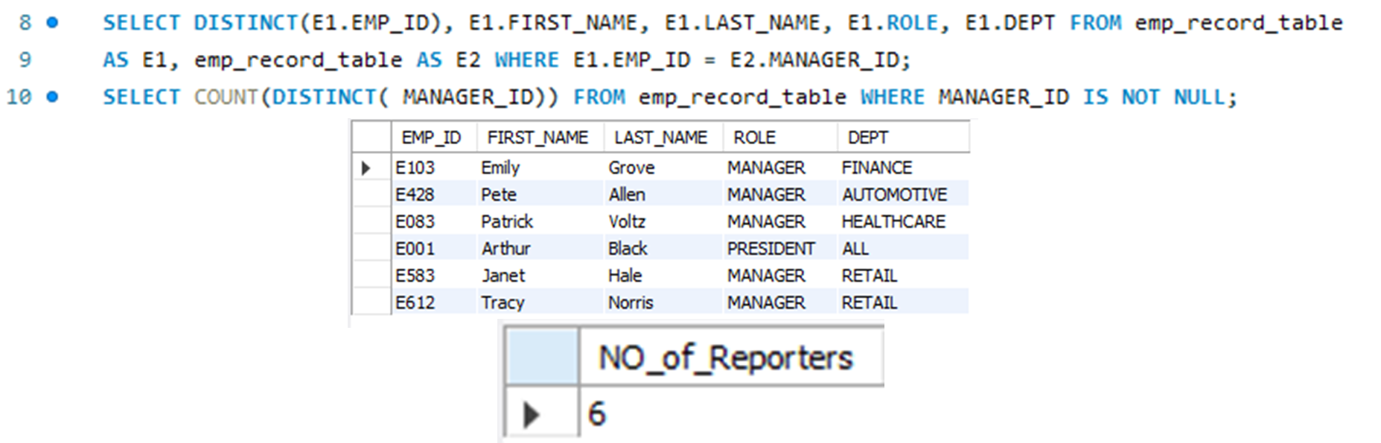
6. Query to list only those employees who have someone reporting to them, Also show the number of reporters (including the President).

Slide 8
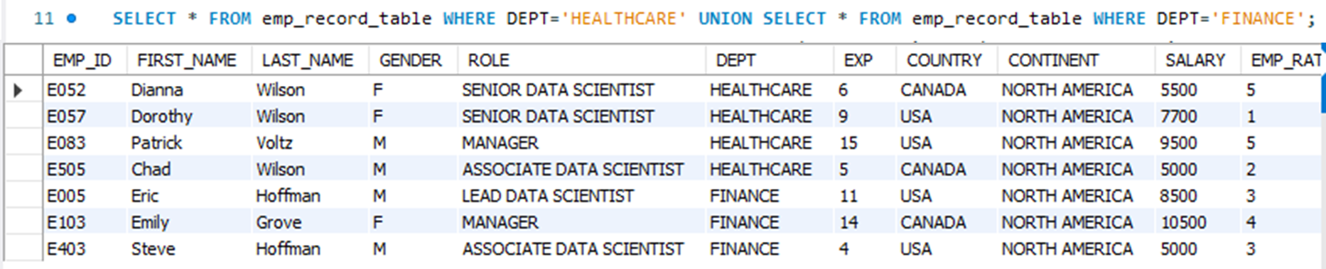
7. Query to list down all the employees from the healthcare and finance departments

Slide 9
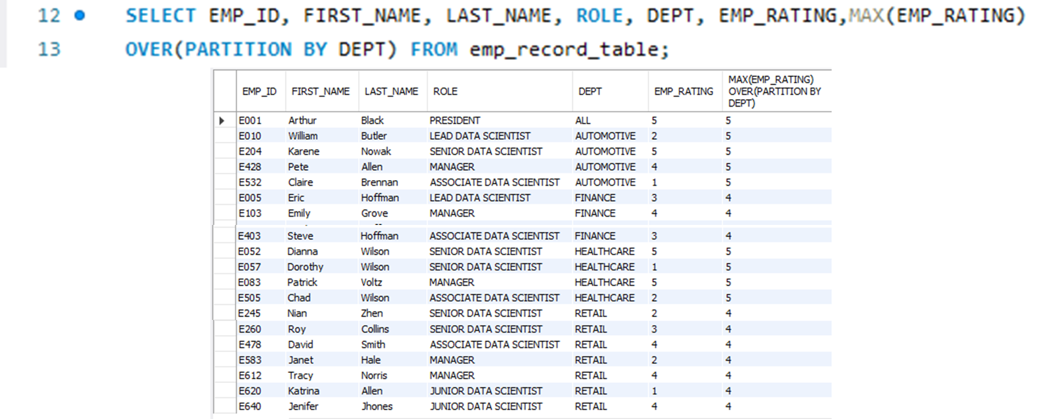
8. Query to list down employee details grouped by department. Also include the respective employee rating along with the max emp rating for the department.

Slide 10
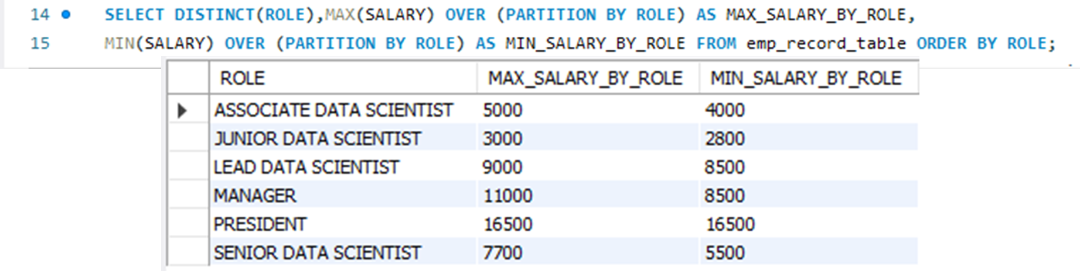
9. Query to calculate the minimum and the maximum salary of the employees in each role

Slide 11
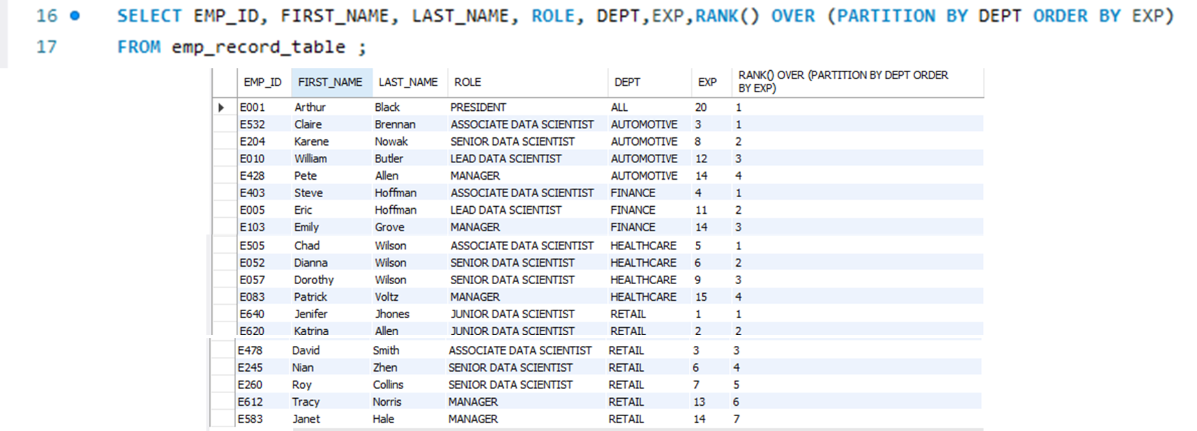
10. Query to assign ranks to each employee based on their experience. Take data from the employee record table.

Slide 12
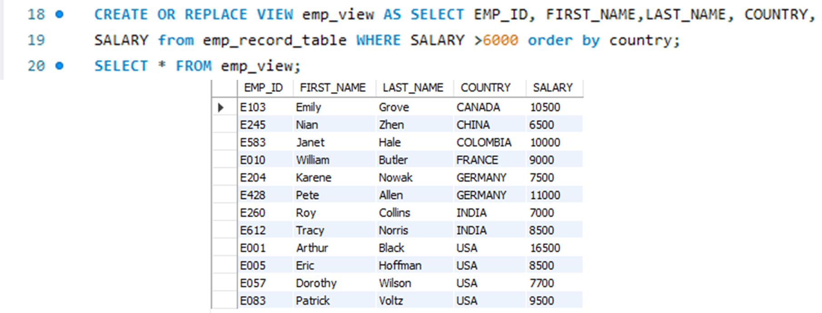
11. Query to create a view that displays employees in various countries whose salary is more than six thousand

Slide 13
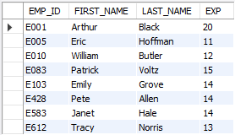
12. Nested query to find employees with experience of more than ten years

Slide 14
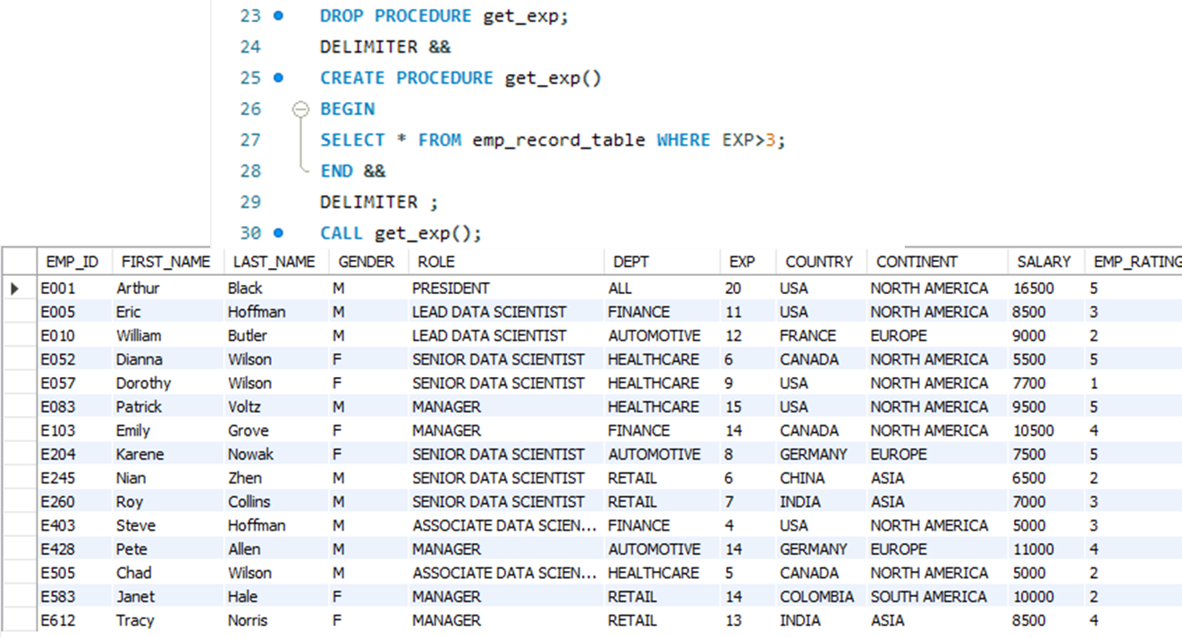
13. Query to create a stored procedure to retrieve the details of the employees whose experience is more than three years.

Slide 15
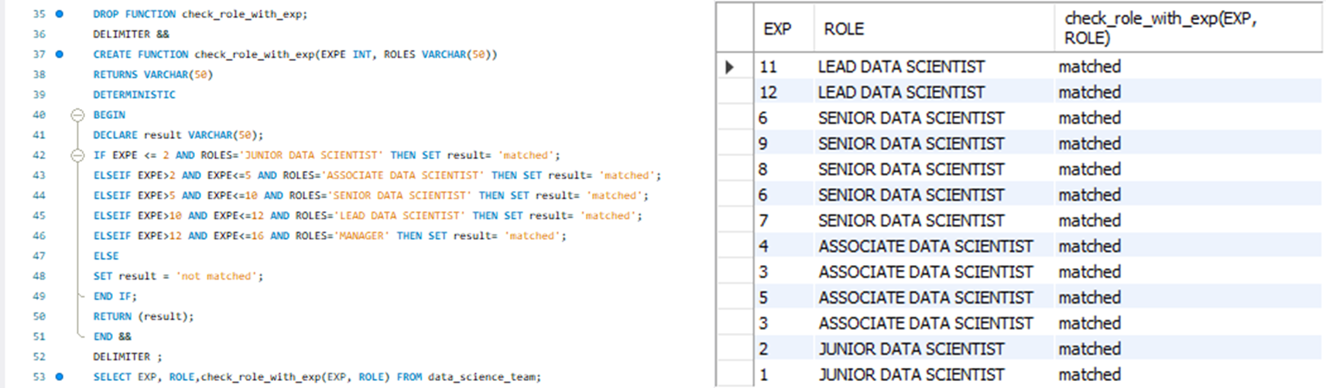
14. Query using stored functions in the project table to check whether the job profile assigned to each employee in the data science team matches the organization’s set standard.

Slide 16
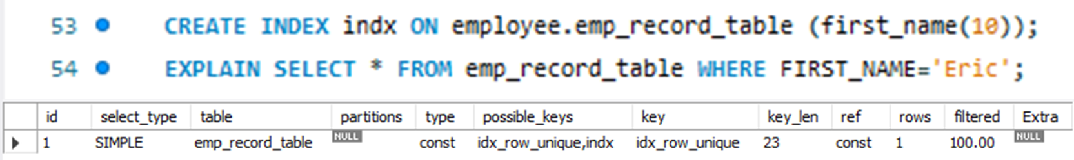
15. Create an index to improve the cost and performance of the query to find the employee whose FIRST_NAME is ‘Eric’ in the employee table after checking the execution plan.

Slide 17
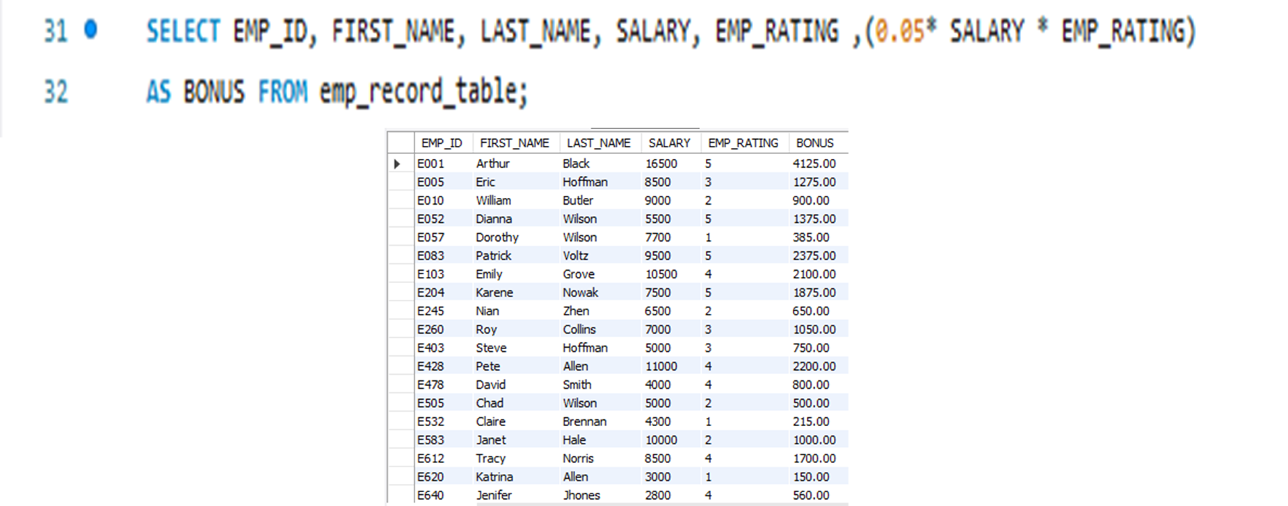
16. Query to calculate the bonus for all the employees, based on their ratings and salaries

Slide 18
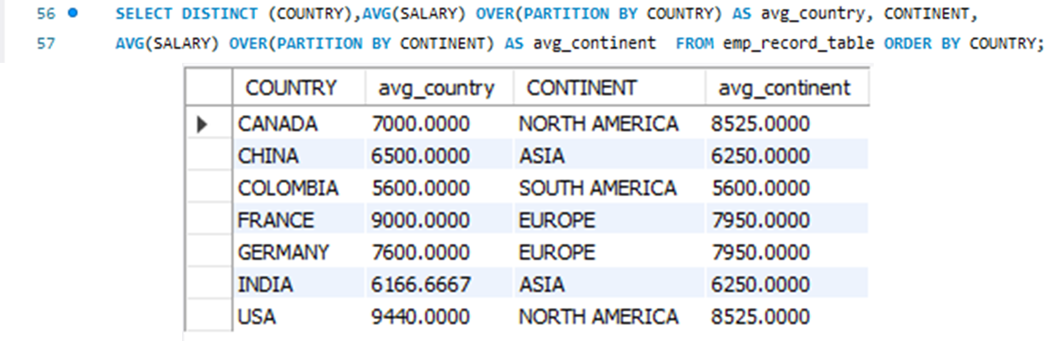
17. Query to calculate the average salary distribution based on the continent and country

